Slide 1
St. Joseph High School Course Selection

Slide 2
AGENDA
Career Exploration is important when choosing courses.
Learn about requirements to graduate
Learn about classes offered at St. Joseph
Learn about registration process

Slide 3
The Classes you choose to take in High School Influence What You Can Study in Post-Secondary & What You Can do for Work After High School
You may be uncertain of your career choice right now….
High School offers a Variety of Subjects…
but choosing the right subjects now will help widen your range of career opportunities.
so choose ones that interest you, ones you will do well in, and ones that fit your personality and values.

Slide 4
On your GSCS Portal, Look for
the Counsellor Connection Tile.

Slide 5
School counsellors can provide students with tools & opportunities to match their skills, interests & values with careers. This helps with course selection in high school.
1. myblueprint.ca
2. saskatooniec.ca/programs

Slide 6
Once you have an idea of the careers that interest you & the schooling required, you can begin to make your high school plan.
Required Courses VS.
Elective Courses
In Grades 10-12 there are 16 REQUIRED classes you must take.
There are a minimum of 8 ELECTIVE classes you choose to take.
TOGETHER they must add up to 24 Credits
to earn a Grade 12 Standing.

Slide 7
Post Secondary
If after graduation, you plan to attend a post-secondary institution, be sure to look at their requirements.
You will need certain high school pre-requisites to take certain post-secondary classes/programs.

Slide 8
Dual Credit Opportunities
There are opportunities for high school students to take a University Class in their Grade 12 year.
Dual Credit means that upon successful completion of the course, students will earn a University Credit AS WELL as a High School Credit.
Example: if you are interested in Edwards School of Business, you can take a Commerce 101 class AND earn a Business 30L. See a counsellor if you are interested.

Slide 9
Class Planning English
GRADE 10 | GRADE 11 | GRADE 12
Catholic Studies 10 | Catholic Studies 20 | Catholic Studies 30
English Lang Arts A10 OR English Lang Arts B10 | Eng Lang Arts 20 | Eng Lang Arts A30
Financial Literacy 10 | 1 Level 20 Math | Eng Lang Arts B30
History/Indigenous Studies 10 | 1 Level 20 Science | History 30 or Indigenous Studies 30
Math: Foundations and Pre-Calculus10 &/OR Math: Workplace and Apprenticeship 10 | 1 20 or 30 Level Social Science (History, Indigenous Studies, Psychology, Law) | 1
Math: Workplace and Apprenticeship 10 | 1 | 2
 |  | 3
Science 10 | 2 | 4
Wellness 10 | 3 | 5
1 | 4 | 6
2 | 5 | 24 credits to graduate 5 of which must be at the 30 Level
3
Notes:
Talk about Biology

Slide 10
Class Planning FRENCH
GRADE 10 | GRADE 11 | GRADE 12
Etudes Catholiques10 | Etudes Catholiques 20 | Etudes Catholiques 30
Histoire 10 | Histoire 20 | Sciences Sociales Immersion 30
Eng Lang Arts A10 OR Eng Lang Arts B10 | Eng Lang Arts 20 | Eng Lang Arts A30 OR Eng Lang Arts B30
Français Immersion 10 | Français Immersion Intégré 20 | Français Immersion 30
Fondements des mathématiques … 10 | Français Immersion 20 | 1
Litterarie Financiere 10 | 1 Level 20 Science | 2
Science 10 | 1 | 3
Wellness 10 | 2 | 4
1 | 3 | 5
2 | 4 | 6 12 French credits are required for a Bilingual Diploma

Slide 11
Prerequisites
You are responsible for ensuring you have the proper prerequisites. If not, you will not receive credit for a class. For example, you need MFP10 to take and gain credit for MFO20.
Some classes do not have prerequisites. For example, there is no prerequisite for BFP20.

Slide 12
Registration Handbook
For more information regarding the necessary prerequisites, see the registration handbook on the school website.

Slide 13
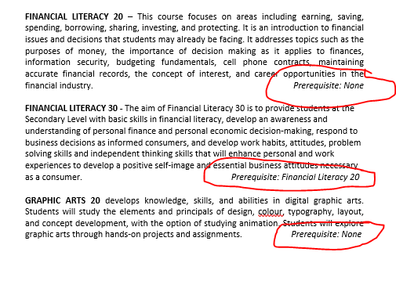
Pre-Requisites – Registration Handbook

Slide 14
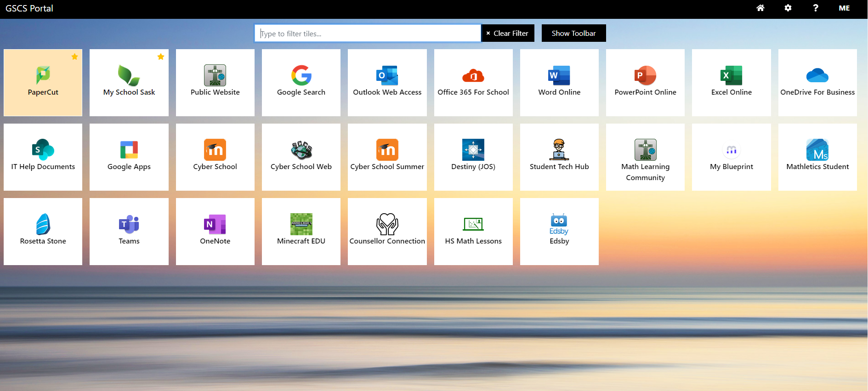
School Transcript in My School Sask (MSS)
How to view your school Transcript in MSS
Log onto your GSCS portal page

Slide 15
School Transcript in My School Sask (MSS)
Click on the MSS Icon
Click on My Info Top Tab
Click on Transcript Side Tab

Slide 16
Viewing your School transcript
Transcript View
Credit Summary

Slide 17
Viewing your Timetable
Click on My Info Top Tab and Current Schedule Side Tab to view (use the drop down to see S1, S2, FY)

Slide 18
Math Pathways
Students choose Math Pathways based on what they believe will best meet their
interests and needs after high school.
Workplace & Apprenticeship Math
This pathway is intended for
students pursuing careers in the
trades & general workplace.
Foundations of Math
This pathway is intended for students who will
pursue careers in social science and humanities at post-secondary.
Pre-Calculus
This pathway is intended for students who will pursue careers in math and natural sciences.

Slide 19
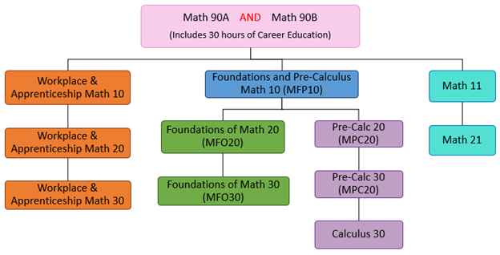
Math Pathways
Students cannot jump from one pathway to another.
ie: you can’t take Workplace & Apprenticeship Math 10 and then take Foundations of Math 20

Slide 20
Grade 10 Math Options
Math Foundations and Pre-Calculus 10 (MFP10)
AND/OR
Workplace and Apprenticeship 10 (MWA10)

Slide 21
Grade 10 Supported Math Option
Yearlong Foundations of Math and Precalculus 10 is designed for a student who is capable of regular curriculum but benefits from the pace being slowed down. MFP10Y is covered over two semesters.
Please discuss with your math teacher, counsellor or administrator if interested in this program.

Slide 22
Grade 11 Math Option
Stretched math is designed for a student who is capable of regular curriculum but benefits from the pace being slowed down. MF020/30S is covered over three semesters.
If you are interested in stretched math talk with your math teacher, guidance counsellor or admin.

Slide 23
Stretched Math Semester Visual
 | Semester 1 | Semester 2
Grade 10 | MFP10Y (Yearlong) | MFP10Y (Yearlong)
Grade 11 | MFO20 and MFO30 over three semesters | MFO20 and MFO30 over three semesters
Grade 12 | MFO20 and MFO30 over three semesters

Slide 24
Advanced Math Pathway
Students who are interested in challenging the AP Math exam in Grade 12 students are recommended to register for the following courses in the corresponding grade over the next few years.
 | Semester 1 | Semester 2
Grade 10 | MFP10 | MFO20
Grade 11 | MPC20 | MPC30
Grade 12 | CAL30 | ICAL30

Slide 25
Advanced Placement
ENGLISH
Student enrollment will be reviewed on an annual basis.
FRENCH
Recommended by French Immersion teacher in Grade 12 year.
VISUAL ART
If interested, please discuss with the Art teacher. You can choose VAR20A in Grade 11 and both VAR30P and SAR30P in Grade 12.

Slide 26
The Advanced Program
ENGLISH
ENGLISH invited at the end of grade 9
MATH
MATH invited at the end of grade 9
Bilingual Program Grade 10: Fondements des mathematiques 10
Grade 10 | Grade 11 | Grade 12
ELB10A | ELA20A | ELB30P
 |  | ELA30P(AP Prep)
Grade 10 | Grade 11 | Grade 12
MFP10 | MPC20 | CAL30
MFO20 | MPC30 | ICA30 (AP Prep)

Slide 27
Advanced English 10
Grade 9’s looking to challenge themselves in understanding literature and writing are encouraged to sign up for AP English.
If you are looking for an enriched environment and you meet the following criteria: academic ability, responsibility, and creative and critical thought then you will thrive in AP English.
If interested, register in ELB10A for next year.
Students who register for the Advanced program will be reviewed by the department.

Slide 28
SCIENCE Pathways
Science 90
Science 10
Environmental Science 20
OR Health Science 20
Physical Science 20
Computer Science 20
Biology 30
Physics 30
Chemistry 30
Computer Science 30 - Cyber

Slide 29
Grade 10 Science Option
If you are interested in taking Science 10 and a 20 level Science next year:
It is suggested that you be proficient (80% or higher as a guideline) and a strong student in Science to consider registering for a 20 level Science in grade 10.
You can choose from ESC20 or HSC20 in your Grade 10 year. Both are prerequisites for BIO30

Slide 30
Electives
Animation 20
Baking and Food Prep 20
Band 10, 20, 30
Career and Work Exploration 10, 20 OR A30, B30
Choral 10, 20, 30
Clothing, Textiles & Fashion 10 and 30
Commercial Cooking 10
Communications Media 20, 30
Construction and Carpentry 10
Cabinet Making 20, 30
Drama 10, 20, 30
Design Studies 10, 20, 30

Slide 31
Electives
Entrepreneurship 20, 30
Financial Literacy 20, 30
Food Studies 30
Graphic Arts 20, 30
Law 30
Physical Education 30 (boys/girls)
Photography 10, 20, 30
Psychology 20, 30
Robotics and Automation 10, 20
Music 10, 20, 30
Visual Arts 10, 20, 30
Welding 10, 20

Slide 32
Career and Work Education
For: Grade 11 and 12 students only.
CWE10 and CWE 20 in Grade 11
CWA30 and CWB30 in Grade 12
The class is a combination of classroom hours and workplace hours.
Must have your own transportation.

Slide 33
Feehan Construction Program Sign up for a Flex session Feb. 28th for more information. See a Counsellor for more information.

Slide 34
Band Students
Grade 10 Band is backed with Wellness 10: select BAN10N and BWE10N
Grade 11 and 12 Band is backed with Catholic Studies:
for Grade 11, select BAN20N and CST20N
for Grade 12, select and BAN30N and CST30N
French Immersion students in Band will have a spare every second day

Slide 35
Choral
This is a year-long class that can be an 11th credit.
Choir meets 2 to 3 times a week in the mornings from 7:45 – 8:30.
In Grade 10, select CHO10N
In Grade 11, select CHO20N
In Grade 12, select CHO30N

Slide 36
LAS Program
If you are currently in the LAS program, you will complete course registration with your LAS teacher.

Slide 37
EAL Program
If you are currently in the EAL program, you will complete course registration with your EAL teacher.

Slide 38
Online Registration
You will register through the MSS icon on the GSCS portal
Go to our school website for the power point, registration handbook, registration form and instructions:
https://www.gscs.ca/jos

Slide 39
Note:
Discuss your choices with your family
Do your research for the requirements for post-secondary/career choices
Your course selections need to be verified and finalized by May 31
Timetable changes will not be made in the fall

Slide 40
If you have any questions, please speak to
a Counsellor or Administrator.
Registration deadline is Sunday, March 12 at midnight.

Slide 41
What does the SIEC do?
Our mandate is to provide career development and discovery opportunities for youth, educators, and career practitioners through customized programming

Slide 42
Last year, the SIEC worked with 63,000 youth, 4,800 educators and career practitioners,
and over 650 business and
post-secondary representatives

Slide 43
Each month focuses on a different sector:
October – Healthcare
November – Manufacturing & Mining
December – Tech
February – Business & Entrepreneurship
March – Skilled Trades
April – Public Service
May – Agriculture
www.saskatooniec.ca/spotlights

Slide 45
One day technology career event for high school students
Hosted at the University of Saskatchewan
Features speaker sessions, hands-on workshops and panels
May 1, 2024
Registration opens
www.digitized.usask.ca

Slide 46
Students in grades 10 – 12 gain hands-on skill development and career training while learning from industry professionals
Bootcamps range from 5 – 10 weeks and take place after school.
2023 – 2024 Bootcamps
Autobody
Automotive Mechanics
Culinary
Hairstyling & Esthetics
GameOn! Video Game Design
Machining
3D Printing
3D Animation
Mechanics (Heavy Duty & Ag Tech)
Welding and Fabrication
Robotics
www.saskatooniec.ca/skills-bootcamps

Slide 47
Students in grades 10, 11 & 12 considering a career in the trades gain real-world work experience in the construction, manufacturing, and tourism/hospitality sectors.
Students receive:
competitive wages
high school credits
hours toward an apprenticeship
work alongside a mentor to experience first-hand what the skilled trades are all about
SYIP 2023 Stats:
60 job placements | 59 completed | 26 job offers
15 grade 12's accepted full-time positions | 59 credits granted
www.saskatooniec.ca/syip

Slide 48
-
www.saskatooniec.ca/syip

Slide 49
Career Exploration Resources
SASKATOONIEC.CA
_____________________________________________

